Slide 1


Text Analysis Amazon Kindle Reviews
Project By: Juliet Sieland-Harris, Tristan Demond, Jack McCullers

Slide 2
Introduction / Problem Statement
Amazon is the leading marketplace for ecommerce. With millions of items for sale, and hundreds of thousands of kindle books, reviews for these become more important for consumers to make educated purchases.
Is it possible to create classification and topic models to categorize reviews by performing sentiment analysis?

Slide 3
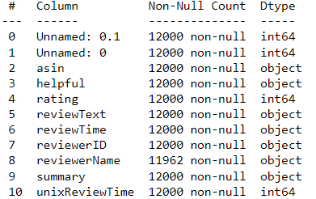
Data Exploration
Dataset: Amazon Kindle Reviews Dataset
12000 Unique Kindle Book Reviews
Columns:
Asin: unique ID of the product
Helpful: Either Yes (1) or No (0)
Rating: 1-5
reviewText: Text review of book
reviewTime: Date of the review
reviewerID: Unique user ID for review
reviewerName: Name of the reviewer
Summary: Brief synopsis of review
Dataset compiled utilizing webscraper for book reviews from Amazon.com

Slide 4
Data Cleaning
Pipeline Functions Developed:
remove_stop: removes stopwords based on tokens
remove_punctuation: removed punctuation from reviewText
Tokenize: splitting on whitespace rather than the book’s tokenize function.
Prepare: prepare the dataset, used on reviewText to populate tokens column
str.lower: convert text to lowercase
Pipeline:
[str.lower, remove_punctuation, tokenize, remove_stop]
Cleaned Data Descriptive Statistics:
4494744 tokens in the data
38 unique tokens in the data
4494744 characters in the data
0 lexical diversity in the data

Slide 5
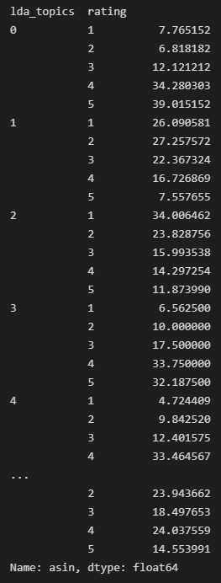
Topic Model
Team created a Topic Model using the following techniques:
NMF
SVD
LDA
Topic Model Results:
Grouped by ratings: 1-5
NMF identified 5 topics
SVD identified 5 topics
LDA identified 10 topics
Conclusions:
Models had highest percentages for predicting ratings of 1 and 2 or 4 and 5 for each topic.
LDA model results highlighted to the left

Slide 6
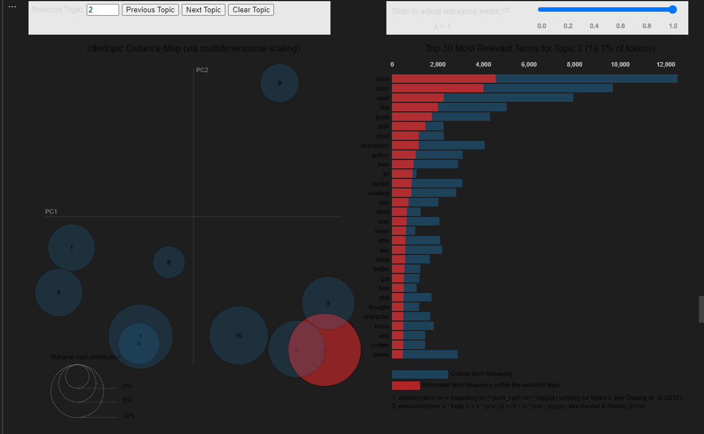
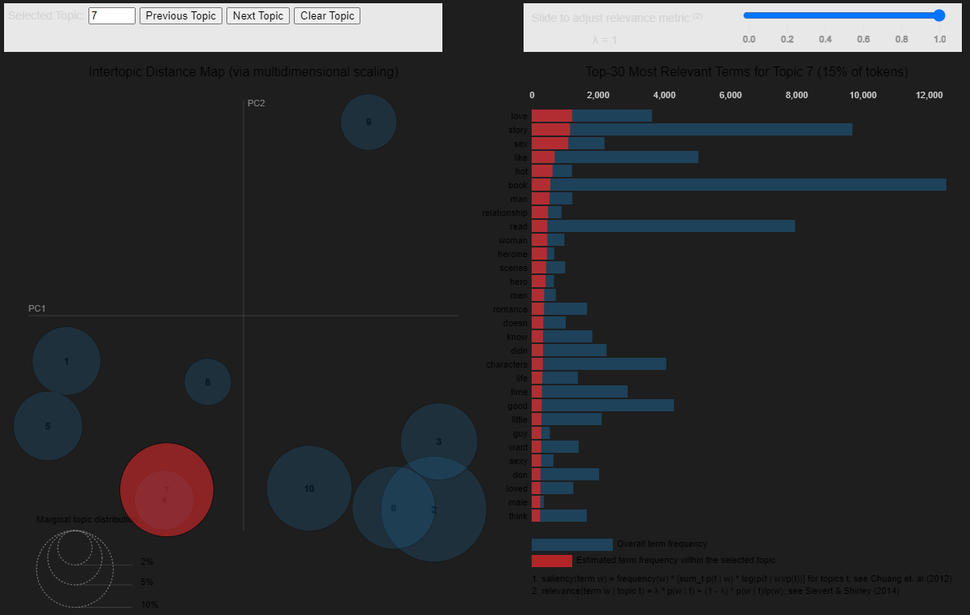

Slide 7
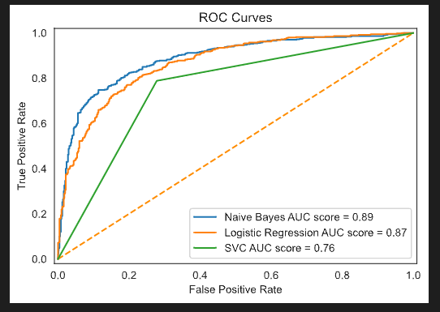
Classification Model
Team created a Classification Model using the following techniques:
Naïve Bayes (main)
Logistic Regression
SVC
First grouped based on Rating:
Topic Model Results:
Accuracy highest for Naïve Bayes model, roughly 91%

Slide 8
Conclusion and Next Steps
Future Opportunities:
Cleaning worked well on initial dataset , room for expanding
Further developing web scraper to pull book reviews from Google Books, NY Times, NPR, and Goodreads
Classification Model Accuracy
Model accuracy was good, but could also be better
The team could try different data cleaning techniques
Utilize the model on a different dataset scraped from a site above to analyze accuracy
Look at other classification techniques besides Naïve Bayes

Slide 9


